Slide 1
OSINT Project
Team 7

Slide 2
Agenda
Team Members and Responsibilities
Project Management Structure
Risk Management and Analysis
Developer Technology Stack
Web API for Programmers
Twitter API
Web Interface for Everyone
Data Generated
Data Analysis
Communications
Possible Future Upgrades
Conclusion

Slide 3
Team 7
Project Manager: James Dumitru
Software Developers: Mahmood Mehrjoo, Kenton Fong, Raymond Ezekiel
Infrastructure & Analysts: Mohammad Salehi, Nikhil Mohanty

Slide 4
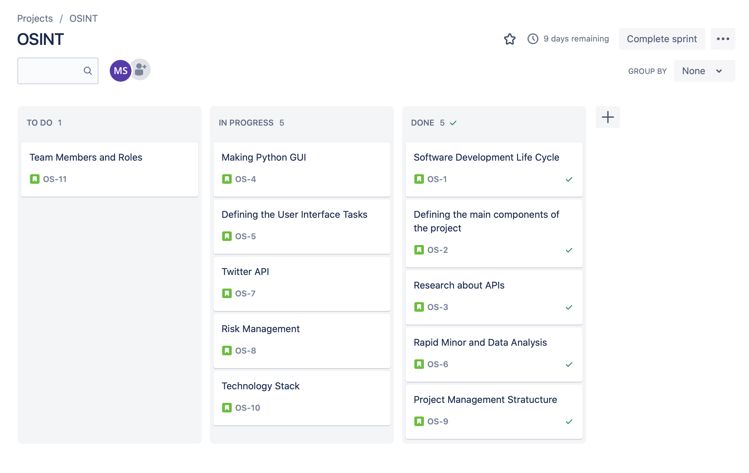
Project Management Structure 1

Slide 5
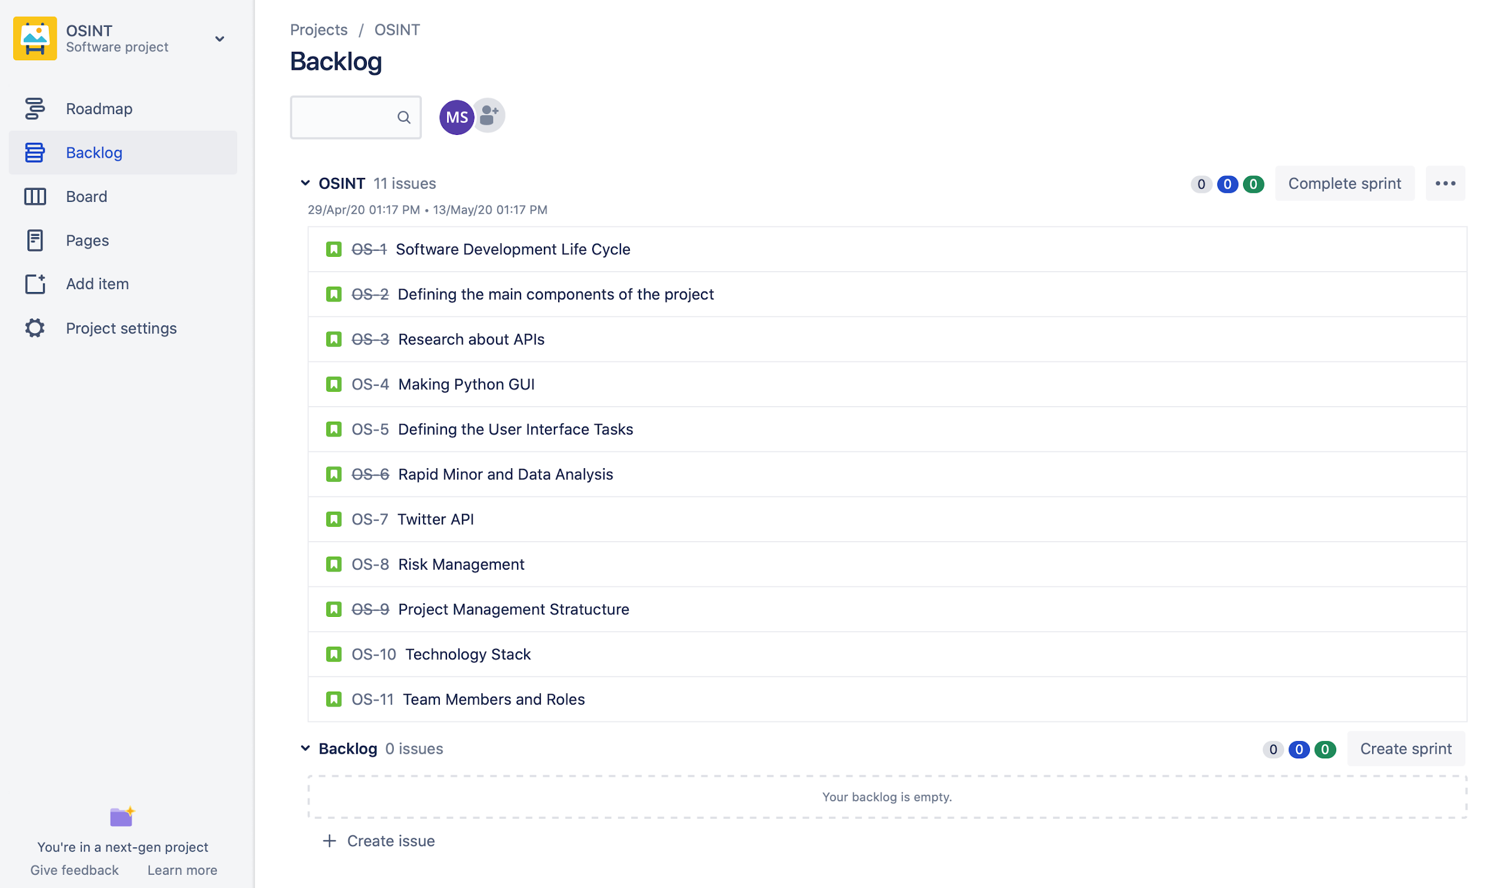
Project Management Structure 2

Slide 6
Risk Management & Analysis
COVID-19
Merge conflicts
Unable to get API of Alibaba site because it was in Chinese Language
Python GUI security concerns
Getting Facebook API
API data integration
Illegal contents might get posted or retrieved
GUI security
Security Implementation on the entire application

Slide 7
Technology Stack
Github
Slack
Twitter, Facebook
Python language

Slide 8
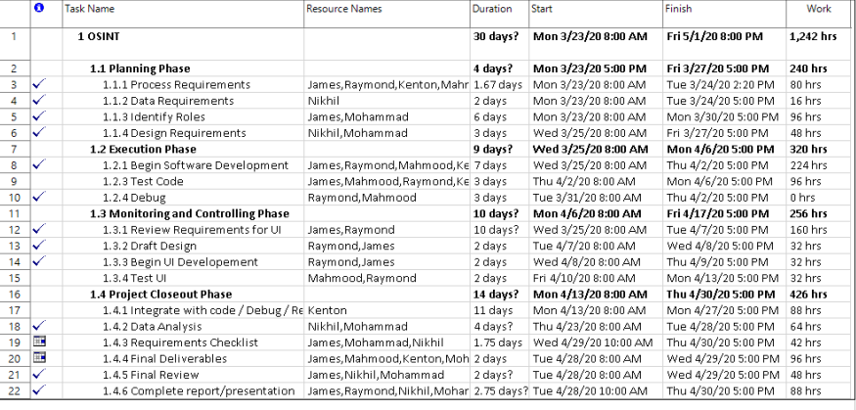
Software Development
Put WBS/Project

Slide 9
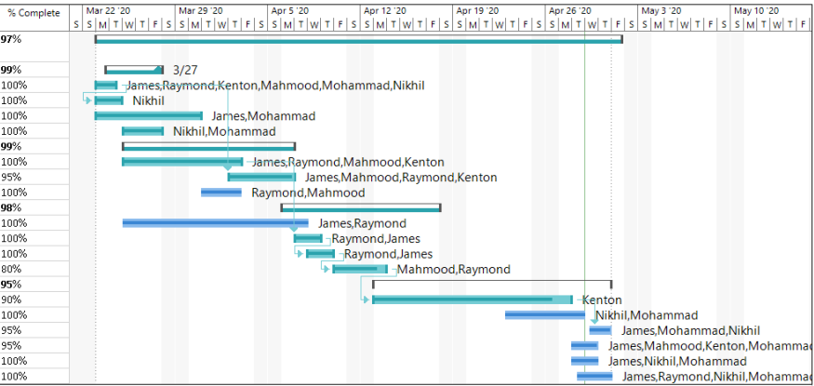
Software Development
Put WBS/Project

Slide 10
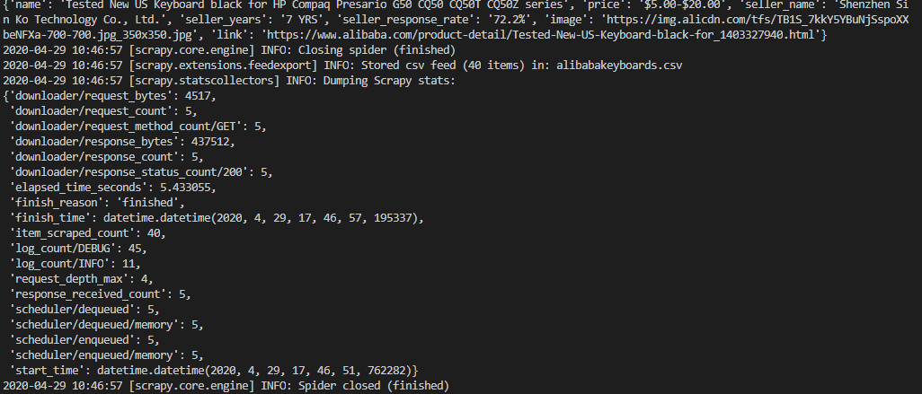
Software Development
AliBaba Keyword Search = “Keyboards”
Storing into CSV file
Notes:
https://github.com/tweepy/tweepy
https://pypi.org/project/python-facebook-api/

Slide 11
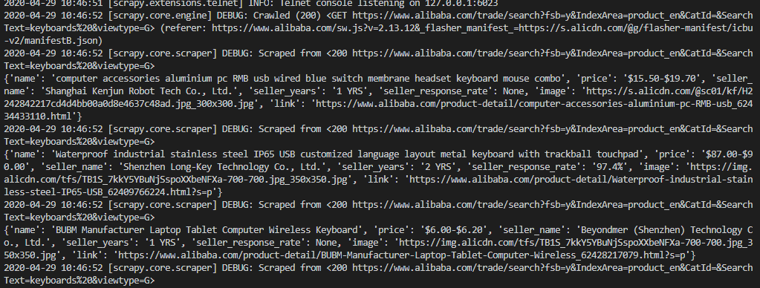
Software Development
AliBaba Keyword Search = “Keyboards”
Storing into CSV file
Notes:
https://github.com/tweepy/tweepy
https://pypi.org/project/python-facebook-api/

Slide 12
Software Development
Walmart Coupon Scraper
Notes:
https://github.com/tweepy/tweepy
https://pypi.org/project/python-facebook-api/

Slide 13
Web API for Programmers
Consumer Keys
API key: xTtYFeA4Ht1JTsIcJlqHcIRQE
API key secret: MKL1C5ZviJy9h9EHPCuwuV7tf6nwSluXseC4W4FWOWNYAVYvAv
Authentication Tokens
Access token: 1254986322458161153-A8lvsLvQylv6Vexg8fnxMbxThRfJYF
Access token secret: c4ILdIgcjnMWNHi6MLYwNKbNBc49CHLzdf2om5cKDIlYz

Slide 14
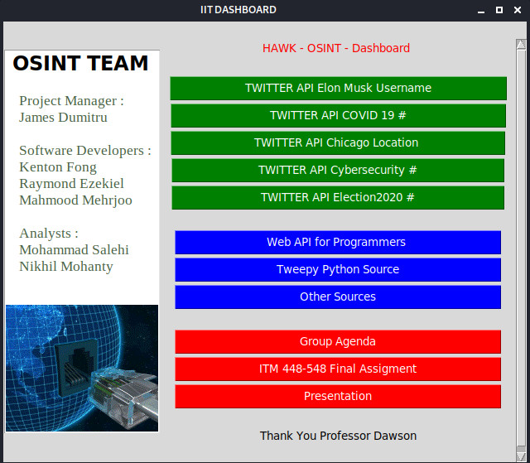
Web User Interface
Dashboard Gui

Slide 15
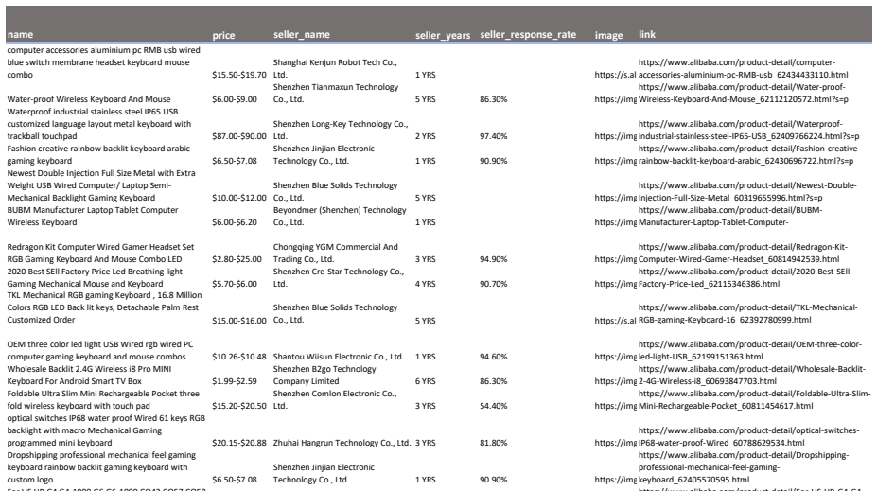
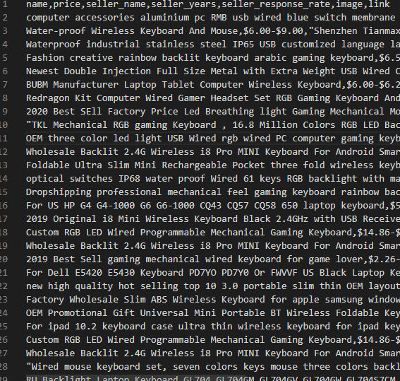
Data Generated
Alibaba Keyboard Keyword Scrape

Slide 16
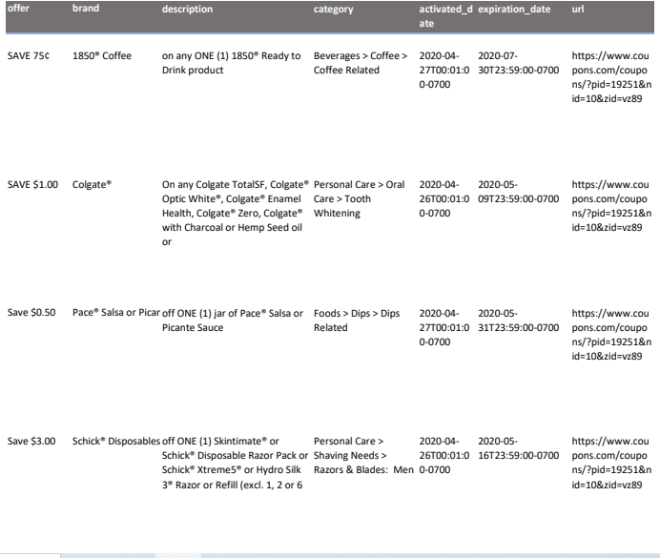
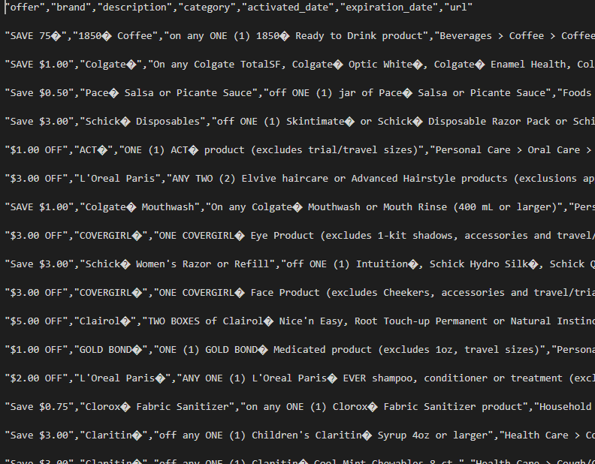
Data Generated
Walmart Coupon Scrape

Slide 17
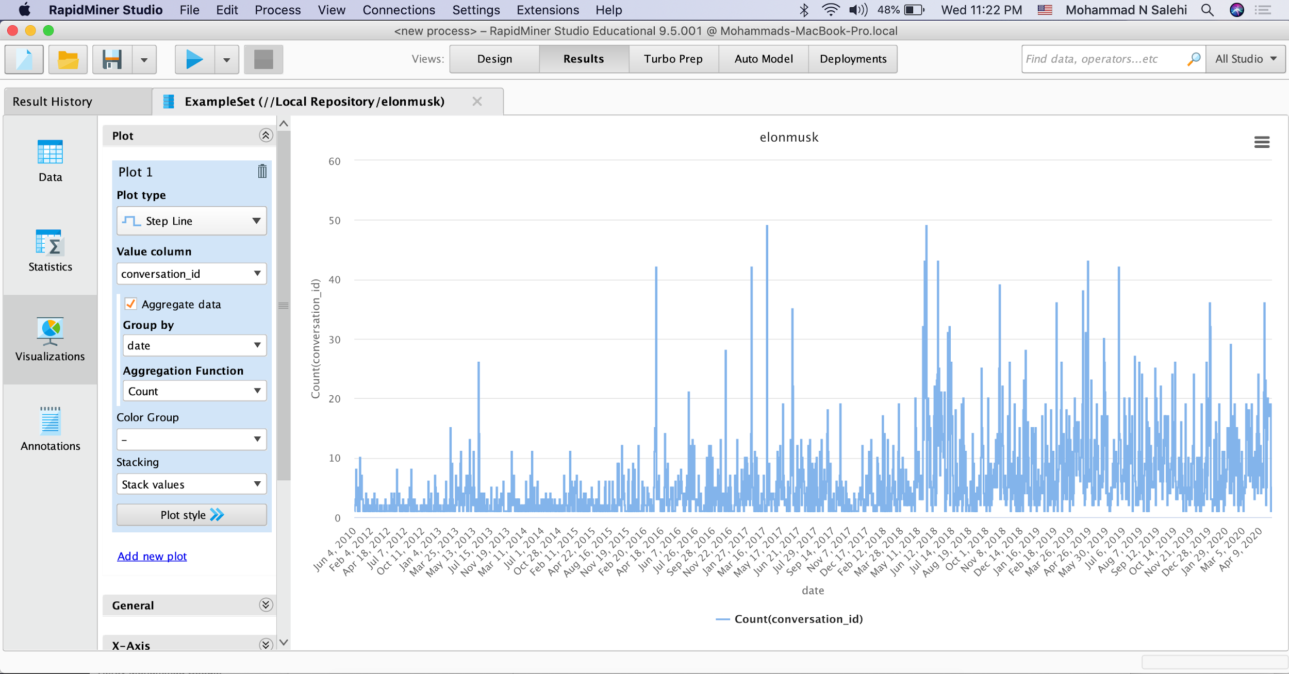
Data Analysis-Elon Musk
Notes:
# of tweets per day of elon musk

Slide 18
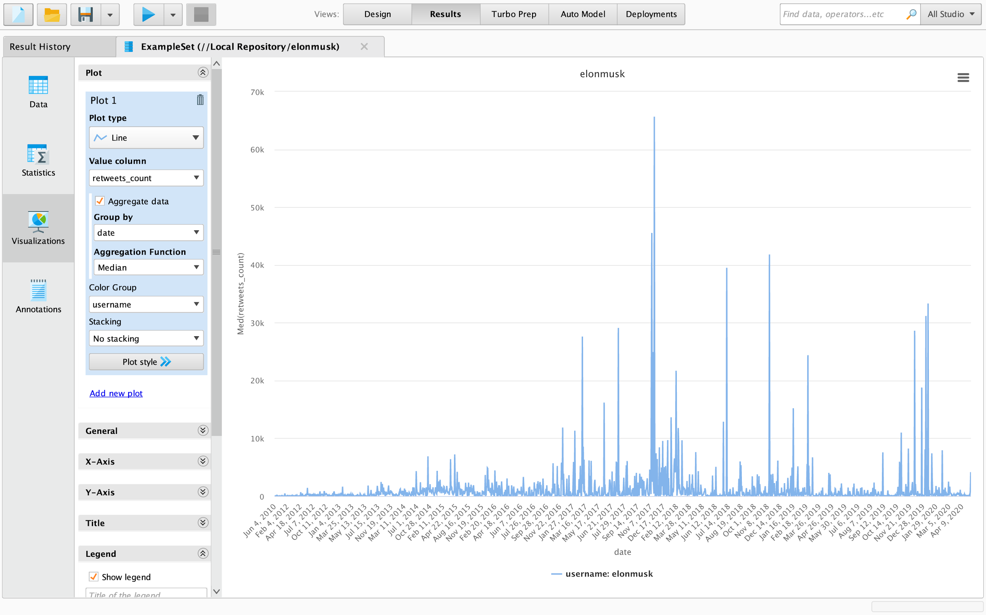

Slide 19
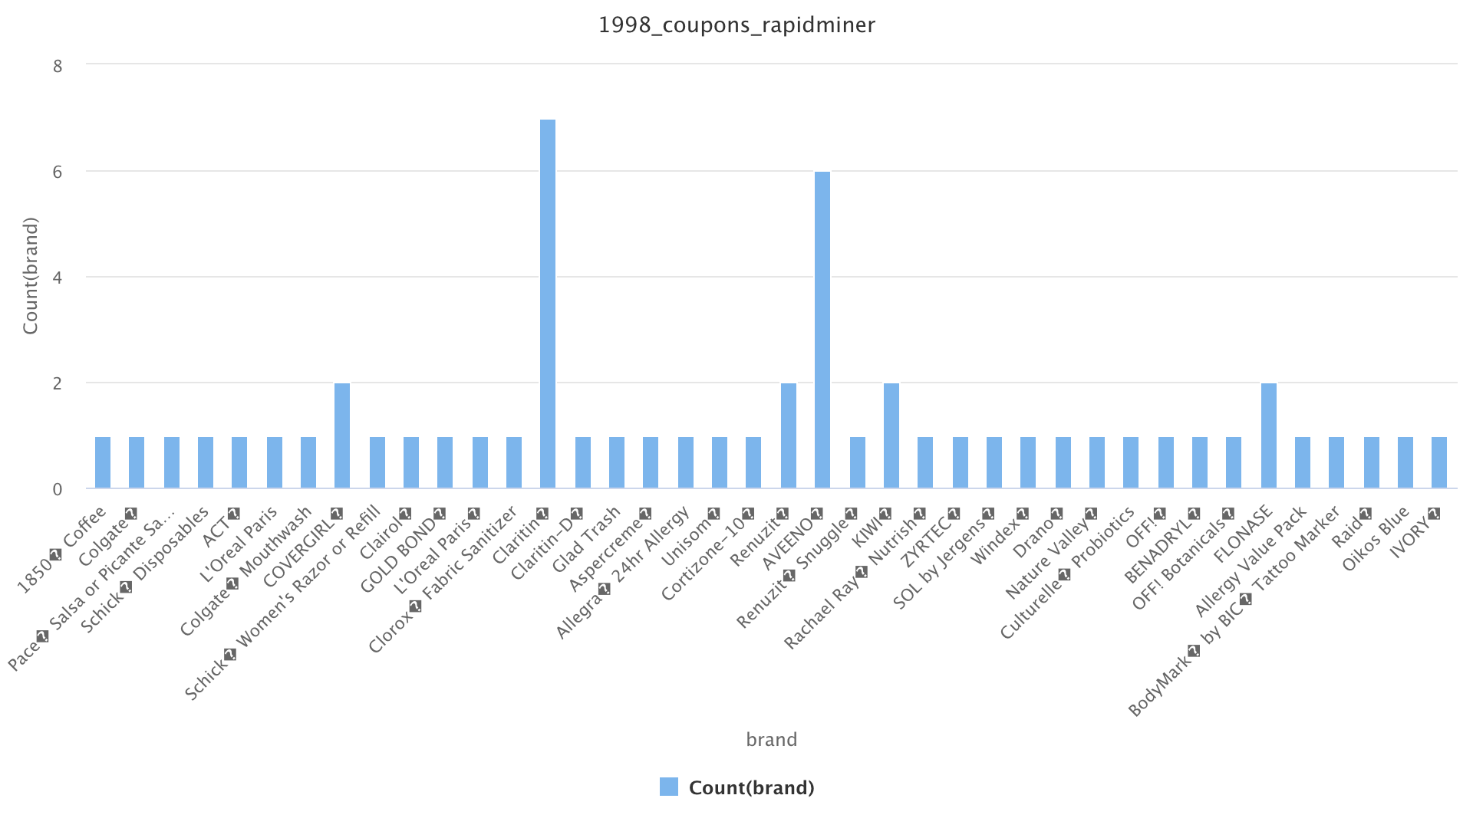
Data Analysis-Coupon Code
Data pulled shows correlation of the # of brand names vs the number of coupons for those brands from Walmart.

Slide 20
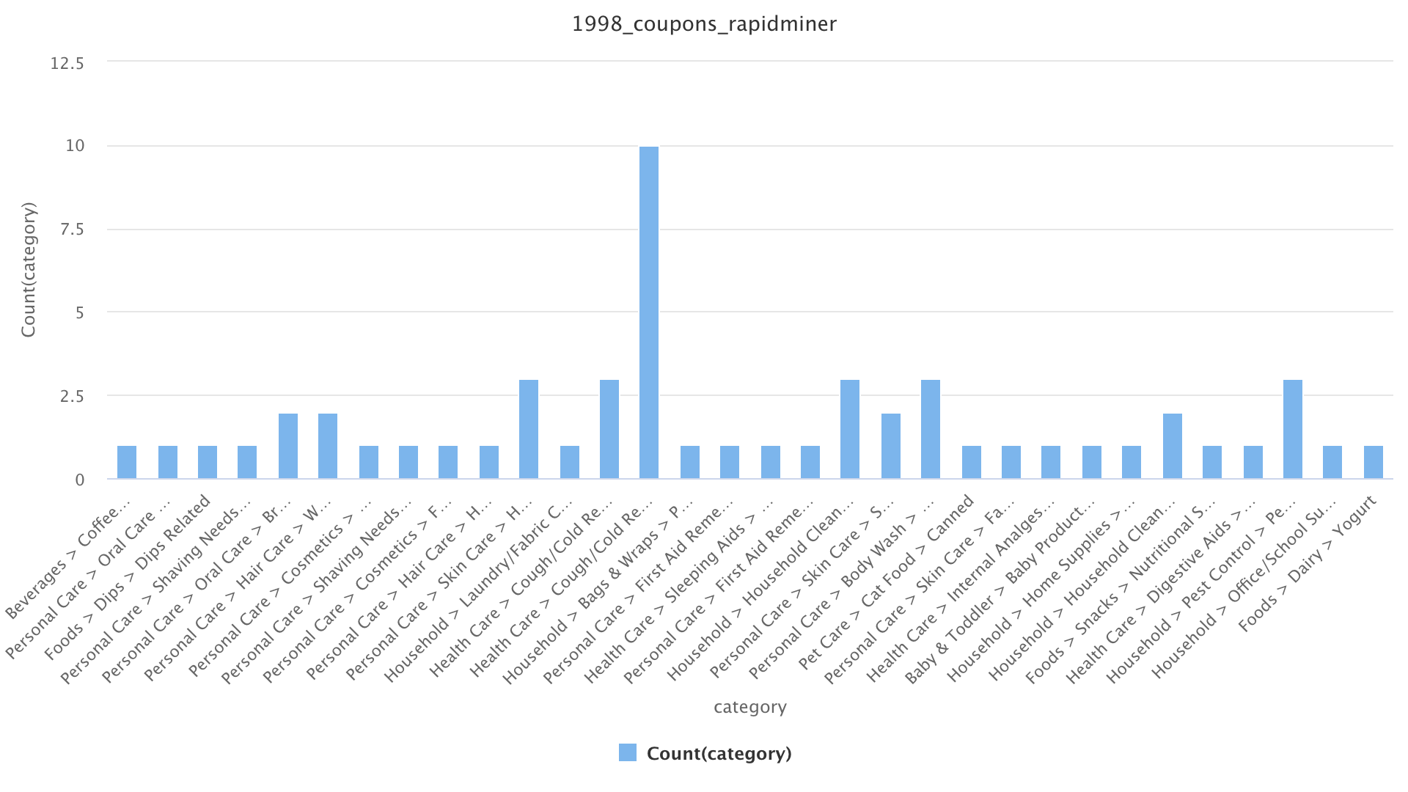
This data shows the most popular coupons based on the categories. Currently, HealthCare products is the most popular category with coupons due to the current situation.

Slide 21
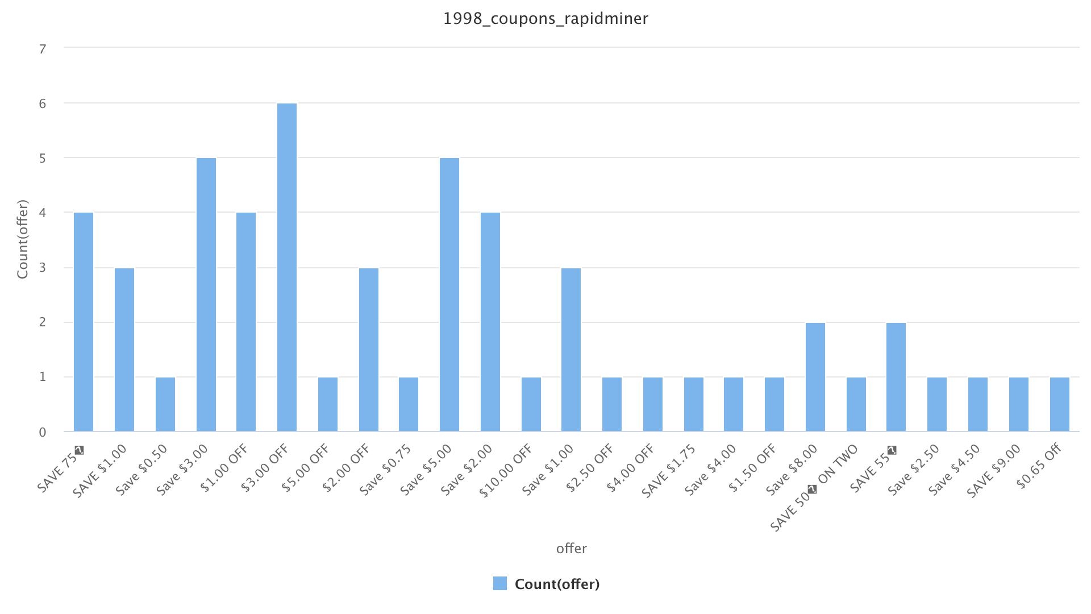
This graph chart shows the count of coupons in terms of how many are made and what the coupon entails.

Slide 22
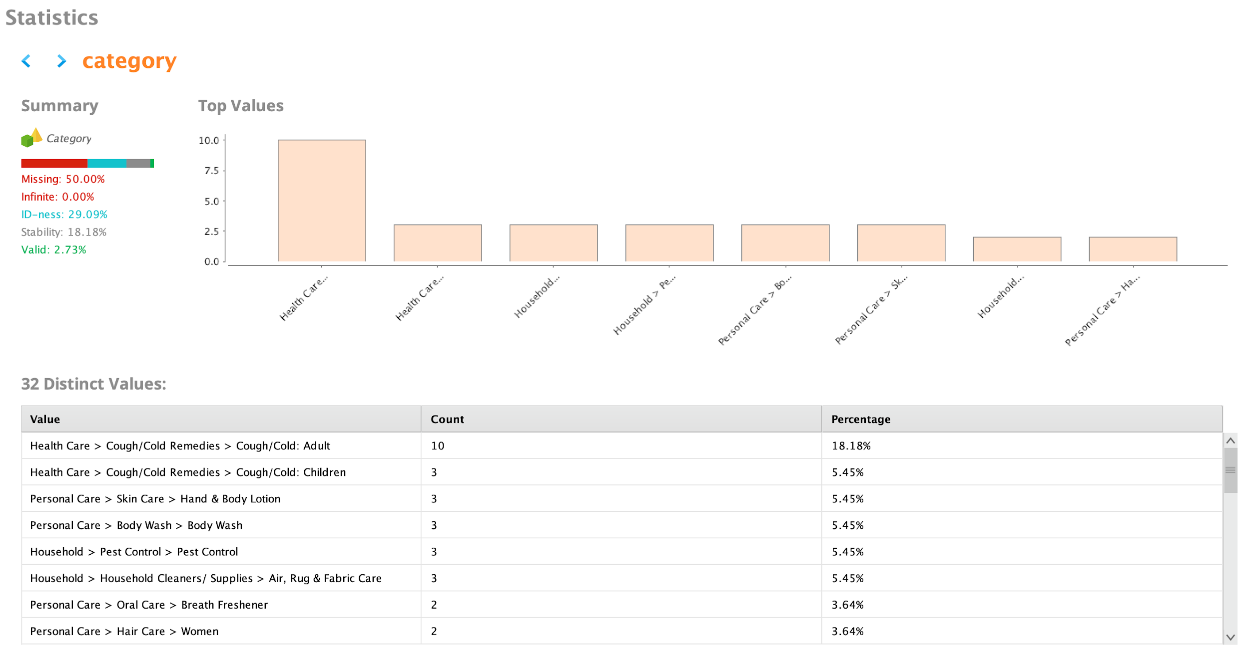

Slide 23
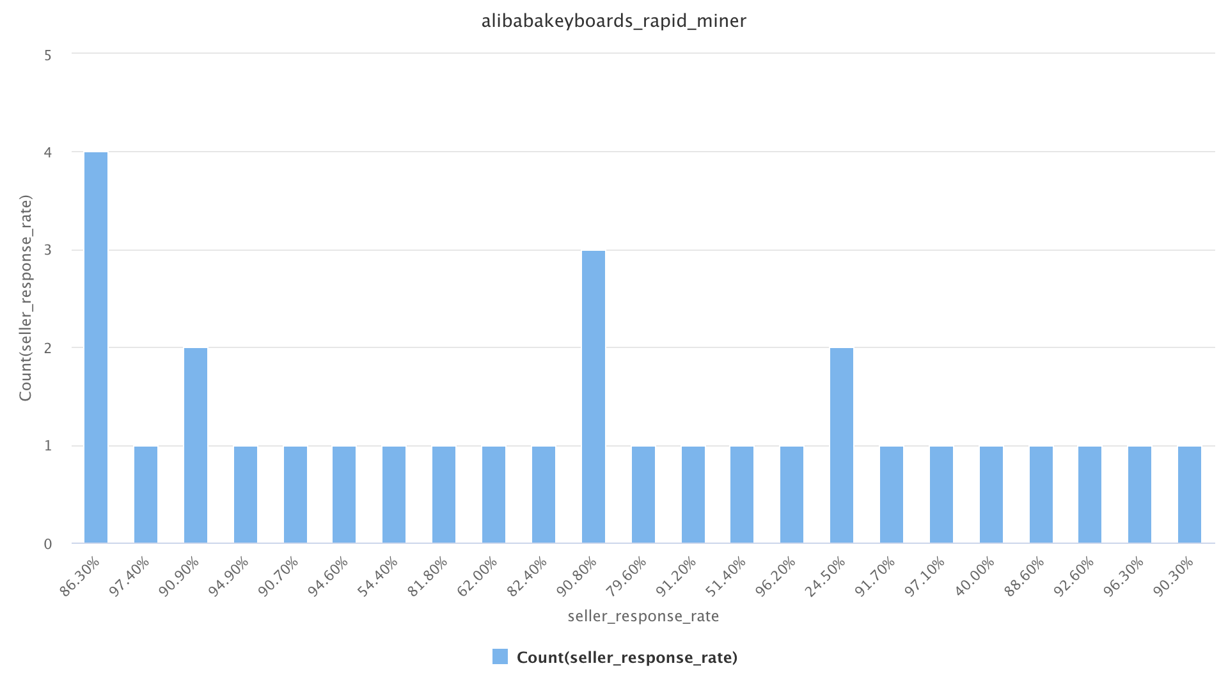
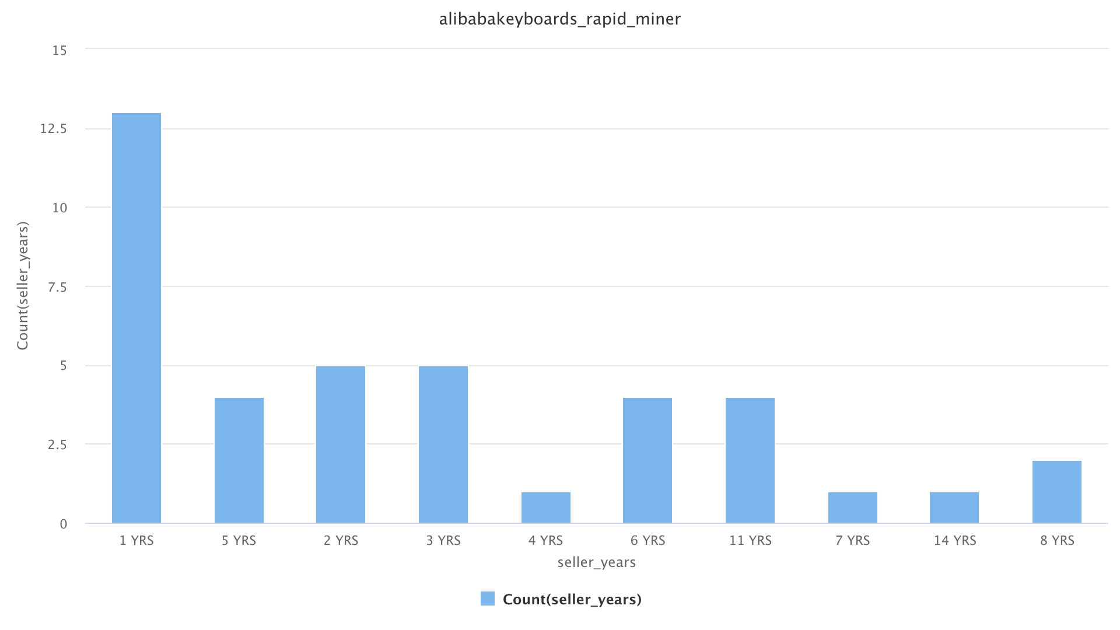
Data Analysis-Keyboard Keyword
Alibaba Keyboard search displays the chart of count and their response time
Alibaba Keyboard search
Results show the correlation between the amount of years sellers have spent on Alibaba

Slide 24


Communications
-Main Communication via WhatsApp
-A Dedicated Google Drive
-GitHub
-Slack

Slide 25
Possible Future Upgrades
An upgrade we could implement would be to search specific things
Make it accessible using a Webapp for anyone to use.

Slide 26
Conclusion
Summarize the entire presentation here

